Slide 1
Artificial Intelligence and COVID-19:
Deep Learning Approaches for Diagnosis and Treatment
M. Jamshidi et al

Slide 2
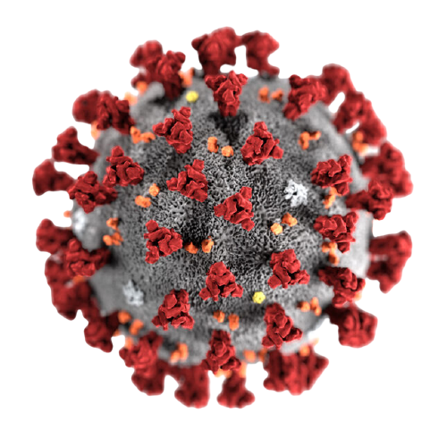
Introduction
We all know about how deadly Covid-19 is.
A respiratory illness which caused pandemic throughout the world.
Determining appropriate approaches to reach solutions for the COVID-19 related problems have received a great deal of attention.
Huge problem that researchers and decision-makers have to deal with is the ever-increasing volume of the data, known as big data, that challenges them in the process of fighting against the virus.

Slide 3
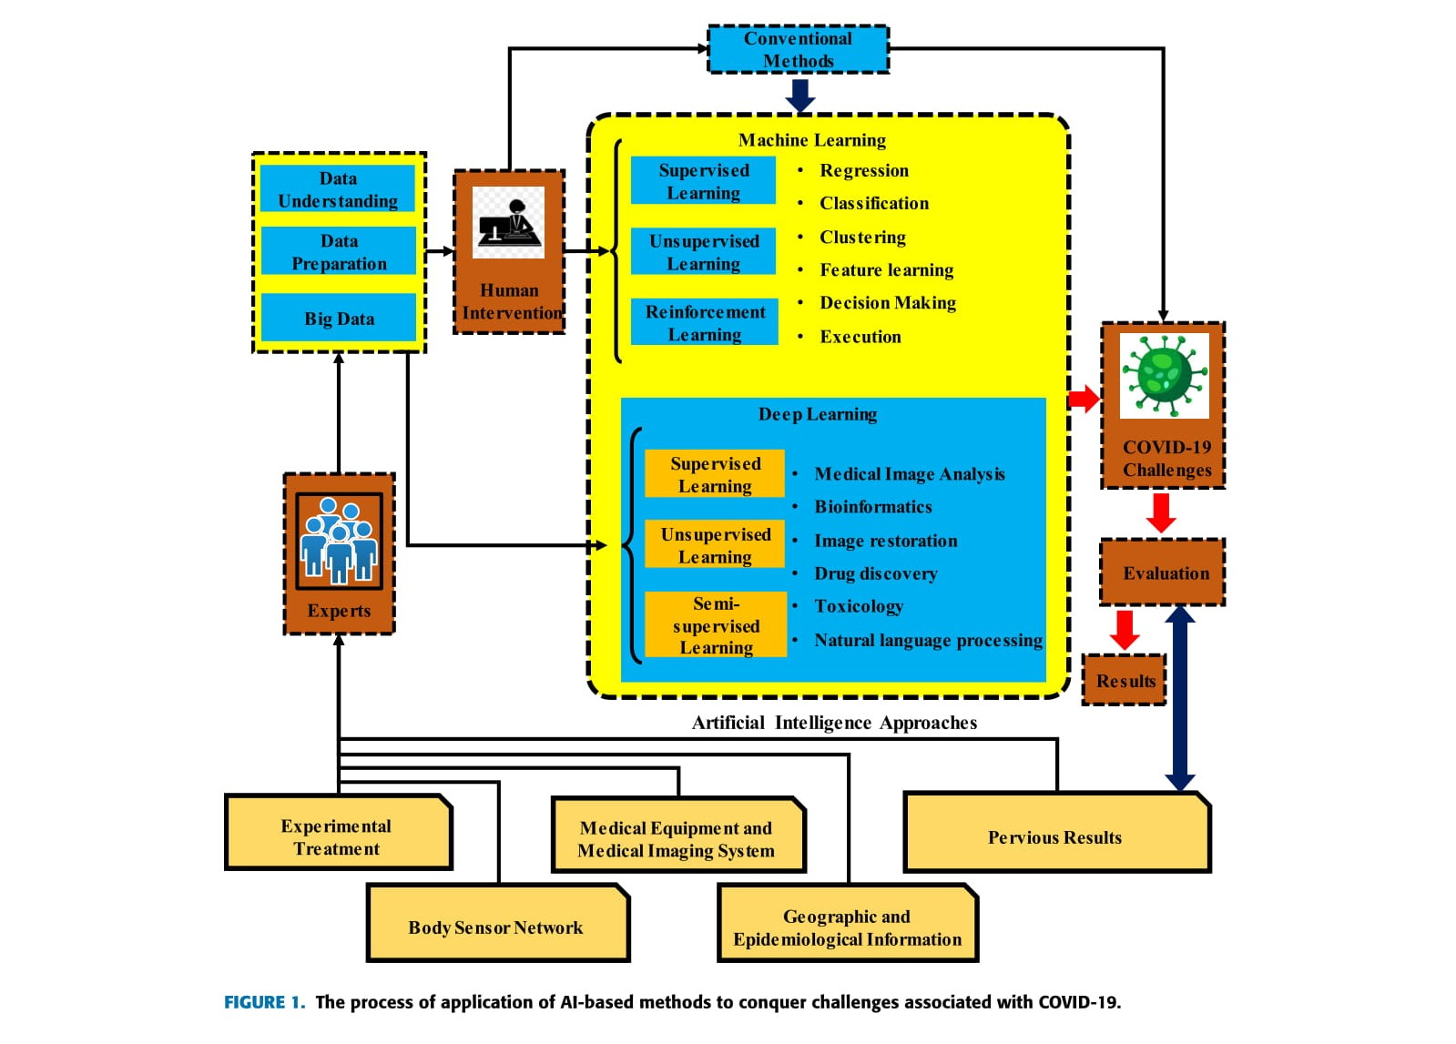

Slide 4
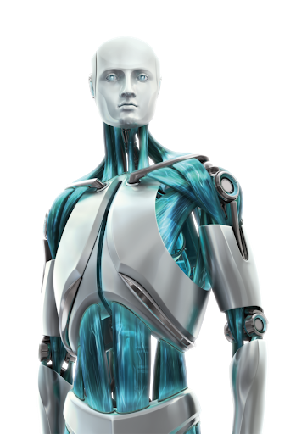
Artificial Intelligence & Covid-19
The first step is the preparation of the data which are necessary for data mining during data understanding, data preparation and big data.
The data consists of medical information, such as clinical reports, records, images and other various forms of information that can be transformed into data that can be understood by a machine.
Before processing and analysis comes data preparation that is the process
through which raw data are refined and converted. a. Collecting, analyzing
and leveraging the data such as consumer, patient, physical, and clinical
data ends in big data.

Slide 5
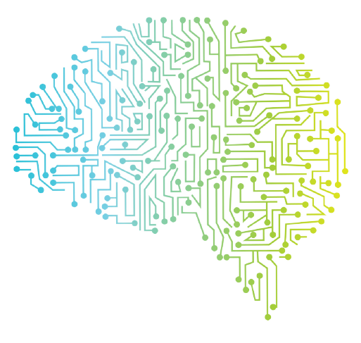
Artificial Intelligence & Covid-19
Humans’ contribution at this stage is important because their knowledge and potentials are not available to an ML solution that unlike humans is able to deal with huge data sets far beyond the extent that humans could handle or observe in a simultaneous manner.
Moreover, Deep Learning (DL) methods could be employed.
DL is different from ML as it presents data in a different manner.
DL networks work by layers of artificial neural networks (ANN).

Slide 6
Flowchart shows various applications of ANN in 5 layers:
Layer 1 -> Layer 2 -> Layer 3 -> Layer 4 -> Layer 5

Slide 7
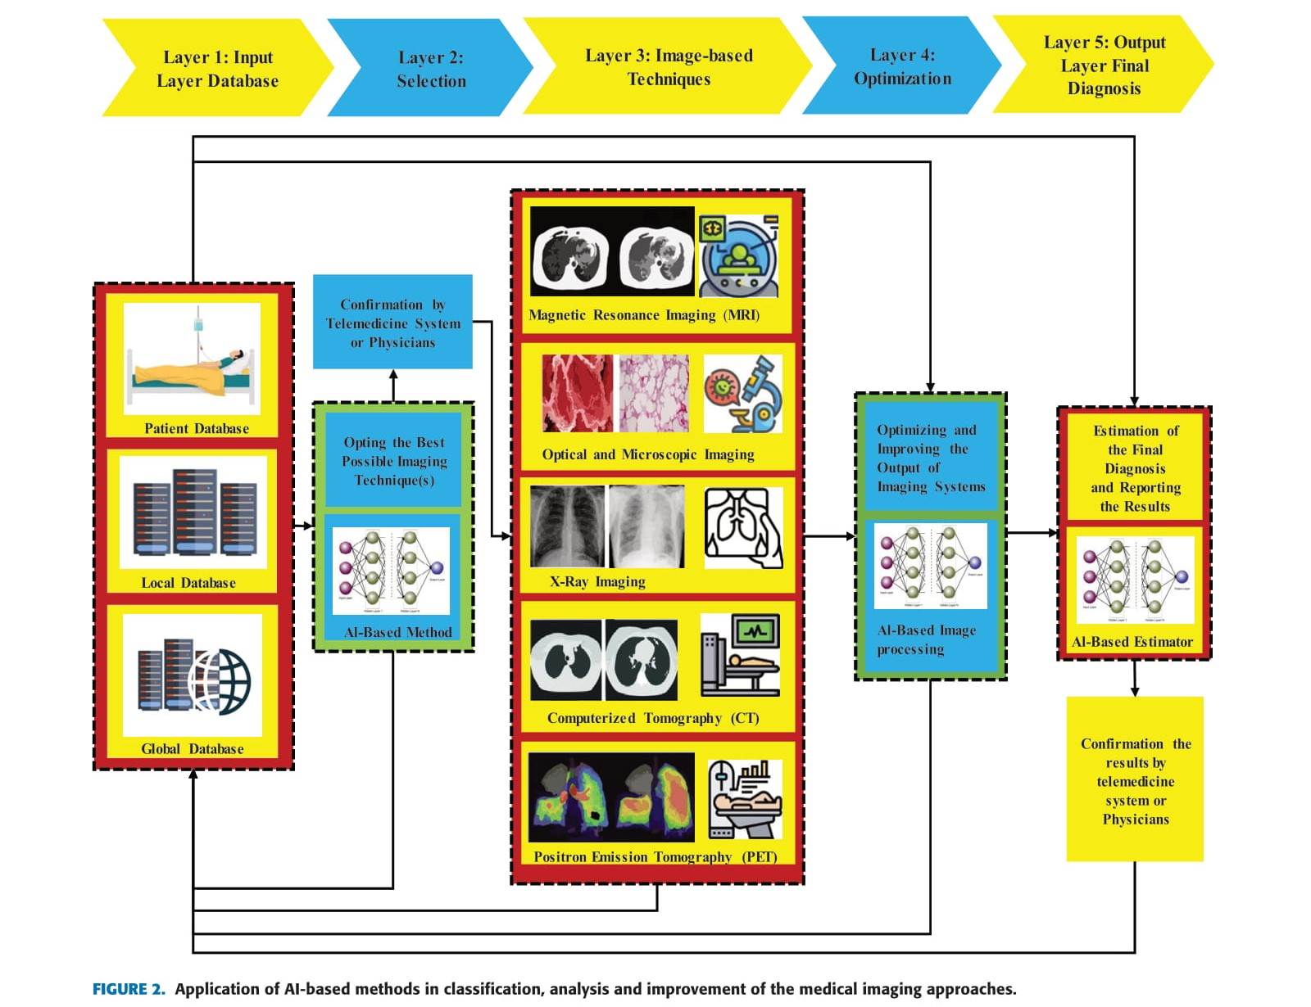

Slide 8
Layer 1: A high-speed channel is used to couple this layer with the main (front-end) computer (s).
Layer 2: This layer uses ANN-based selector. Its task is to adopt best possible imaging techniques. A physician needs to confirm it to go to next layer.
Layer 3: Imaging techniques may be suggested - MRI, CT scan, applications in X Ray imaging etc
Layer 4: Optimization and improvement of images. Discriminating between covid-19 and influenza-A. DL and ResNet is used.
Layer 5: The fifth layer is reserved for ultimate diagnosis based on the system’s saved information and is a layer in which learning algorithms should be done by an ANN method.

Slide 9
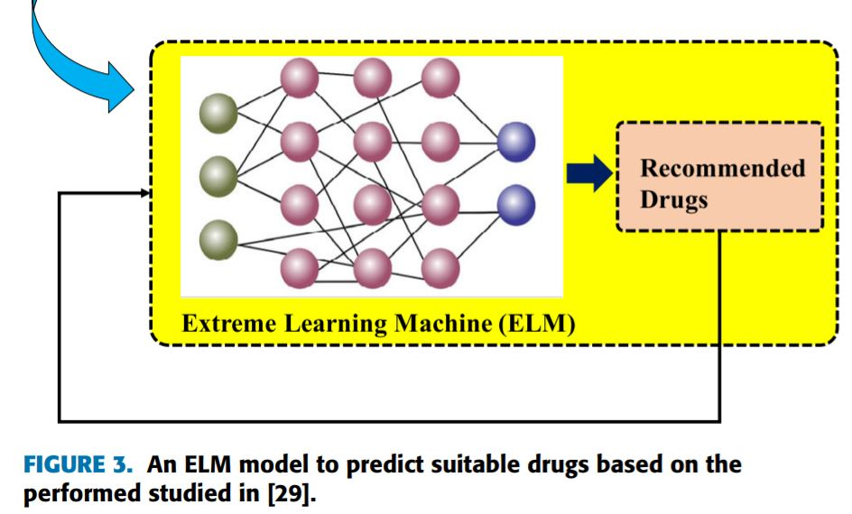
ELM
ELM or extreme learning machine can use previous examples applied to the model to predict desired outputs.
In comparison with conventional feedforward network learning algorithms like back-propagation (BP) algorithm, learning speed in ELM is a greatly faster and obtains better generalization performance

Slide 10
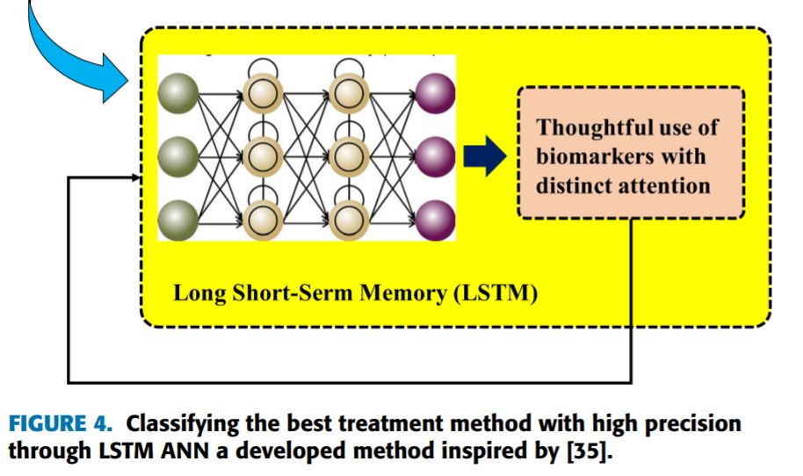
LSTM
LSTM or Long short term memory. Being capable of maintaining long memory, LSTM networks are very advantageous for learning sequences with longer-term patterns of unknown length.
LSTM NN has been popular and increasingly used in robot control, speed recognition, handwriting recognition, human action recognition, etc. over the past ten years

Slide 11
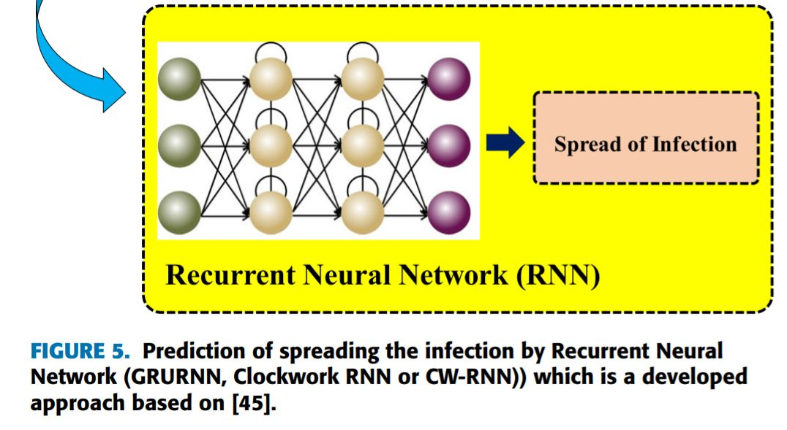
RNN
The main objective of the proposed structure is to improve the accuracy and speed of recognition and classification of the issues caused by the virus by utilizing DL-based methods.

Slide 12
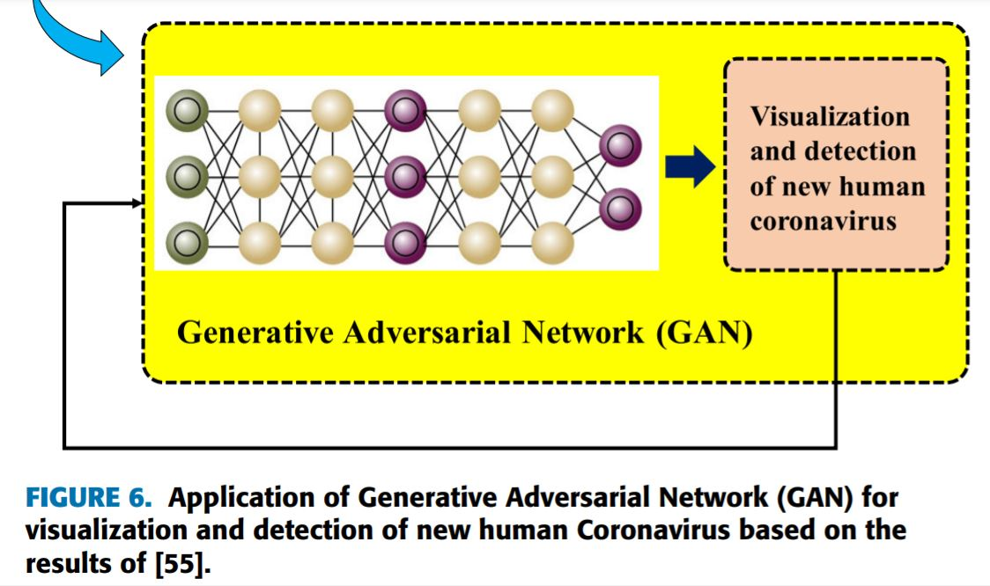
GAN
GANs are a special type of neural network model in which two networks are trained at the same time while one is focused on generating images, and the other performs discriminating. GANs can solve these problems through effective modelling of the latent distribution of the training data.

Slide 13
Conclusion
The geographical issues, high-risk people, and recognizing and radiology were the main problems with COVID-19 and have been studied and discussed in this work.
Succeeding in the combat against COVID-19 toward its eventual demise is highly dependent on building an arsenal of platforms, methods, approaches, and tools that converge to achieve the sought goals and realize saving more lives.

Slide 14
Bibliography
Research Paper Authors - MOHAMMAD (BEHDAD) JAMSHIDI 1 , ALI LALBAKHSH 2 , (Member, IEEE), JAKUB TALLA 1 , ZDENĚK PEROUTKA3 , (Member, IEEE), FARIMAH HADJILOOEI 4 , PEDRAM LALBAKHSH5 , MORTEZA JAMSHIDI6 , LUIGI LA SPADA7 , MIRHAMED MIRMOZAFARI 8 , (Member, IEEE), MOJGAN DEHGHANI9 , ASAL SABET10, SAEED ROSHANI11, (Member, IEEE), SOBHAN ROSHANI11, NIMA BAYAT-MAKOU 12, (Member, IEEE), BAHARE MOHAMADZADE2 , (Student Member, IEEE), ZAHRA MALEK 13 , ALIREZA JAMSHIDI14, SARAH KIANI15, HAMED HASHEMI-DEZAKI 3 , AND WAHAB MOHYUDDIN 16, (Member, IEEE)
Images - Pixabay.com, google images
Information Reference - Wikipedia.org, machinelearningmastery.com

Slide 15
Implementation
Strategy
This paper has provided a lot of strategies on how one can implement it.
As it uses Deep Learning, the implementation will contain:
User inputs Patient data.
Selection of best imaging technique will be selected.
Image techniques will be carried out.
Optimization of output.
FInally, we will get the estimate of diagnosis.

Slide 16
Thank You!

